Slide 1
REST APIs
A practical guide

Slide 2
REST – Representational State Transfer
    Fielding, Roy Thomas. “Architectural Styles and the Design of Network-Based Software Architectures.” PhD Thesis,
    UNIVERSITY OF CALIFORNIA, 2000.
Six Constraints:
  Uniform Interface
    All interactions use the same form (typically HTTP)
    Resources on the provider side are identified by URIs
    Naming conventions should be consistent
    Follow the principle of least surprise
  Client-server
  Stateless – the client should assume the server never retains any state information between requests
  Cacheable – caching is applied to resources when applicable
  Tiered System Architecture – The server may be broken into independent elements
  Code on Demand – It is possible for the server to provide client to be executed

Slide 3
Key Elements of REST APIs - 1
Resources
The first key element is the resource itself. Records are identified by a URI (Universal Resource Identifier):
URI = scheme ":" ["//" authority] path ["?" query] ["#" fragment]
  Let assume that a web application on a server has records of several employees.
  Let's assume the URL of the web application is https://jsonplaceholder.typicode.com.
  Now in order to access a user record resource via REST, one can issue the command https://jsonplaceholder.typicode.com/users/1
    This command tells the web server to please provide the details of the user whose user number is 1.

Slide 4
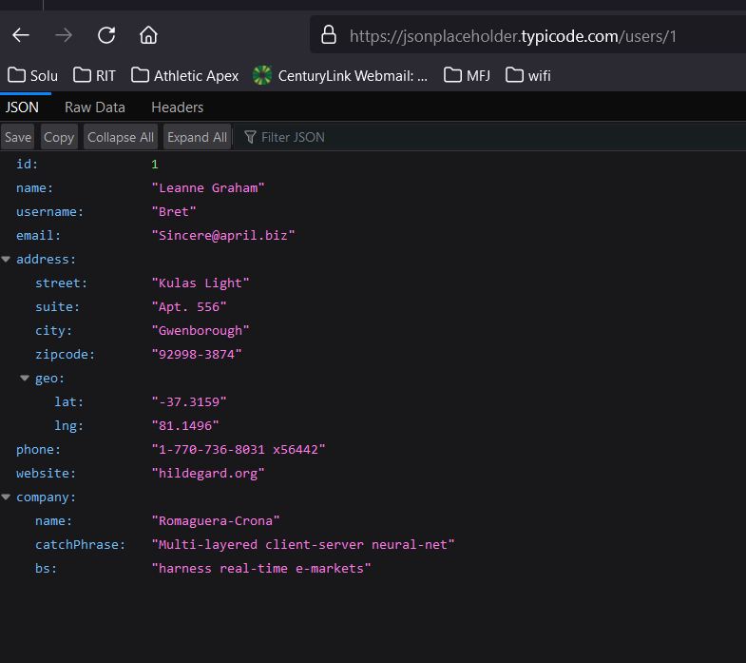
  https://jsonplaceholder.typicode.com/users/1

Slide 5
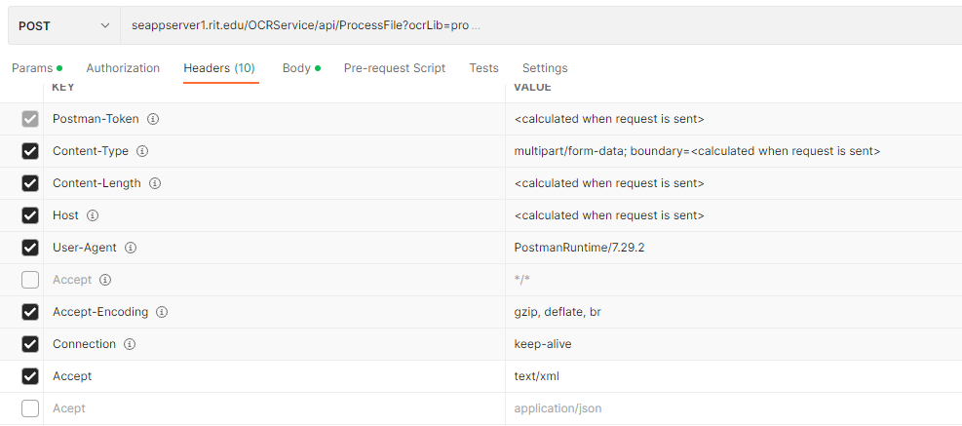
Key Elements - 2
Commands
These describe what you want to do with the resource. A browser issues a GET command to instruct the endpoint it wants to get data.
  HTTP Command | CRUD Operation Equivalent
  POST | create
  GET | read
  PUT | update / replace
  PATCH | update / modify
  DELETE | delete
Request Headers
These are additional instructions sent with the request. These might define the type of response required or the authorization details. An example of headers from Postman:

Slide 6
Key Elements - 3
Request Body
Data is sent with the request. Data is normally sent in the request when a POST request is made to the REST web service. In a POST call, the client actually tells the web service that it wants to add a resource to the server. Hence, the request body would have the details of the resource which is required to be added to the server.
Response Body
This is the main body of the response. So in our example, if we were to query the web server via the request https://jsonplaceholder.typicode.com/users/1, the web server might return an XML document with all the details of the employee in the Response Body.
Response Status codes
These codes are the general codes which are returned along with the response from the web server. An example is the code 200 which is normally returned if there is no error when returning a response to the client.

Slide 7
Key Elements - 4
Restful Methods
The below list shows the verbs (POST, GET, PUT, and DELETE) and an example of what they would mean.
Let's assume that we have a RESTful web service is defined at the location. http://demo.guru99.com/employee . When the client makes any request to this web service, it can specify any of the normal HTTP verbs of GET, POST, DELETE and PUT.
Below is what would happen If the respective verbs were sent by the client.
POST – This would be used to create a new employee using the RESTful web service
GET - This would be used to get a list of all employees using the RESTful web service
PUT - This would be used to update all employees using the RESTful web service
DELETE - This would be used to delete all employees using the RESTful web service

Slide 8
An example
Let's take a look from a perspective of just a single record. Let's say there was an employee record with the employee number of 1.
The following actions would have their respective meanings.
POST – This would not be applicable since we are fetching data of employee 1 which is already created.
GET - This would be used to get the details of the employee with Employee number 1 using the RESTful web service
PUT - This would be used to update the details of the employee with Employee number 1 using the RESTful web service
DELETE - This is used to delete the details of the employee with Employee no. as 1

Slide 9
Why REST?
Advantages
Disadvantages
Standardization
Sort of … it’s a loosely defined standard. No strict rules for syntax or behaviour. More guidelines
Simple interface representation
As long as you can encode the data (usually json), you have your interface
Readable
Again, json
Easy to CREATE APIs
Human readable, no special tools (unlike SOAP)
Loose syntax and semantics
Interface basically enforced in code
Often, a RESTful implementation is not (RESTful)
There’s no real way to enforce the principles
REST, to a large degree, owes it’s growth to adoption by Google, Facebook, Twitter … and it’s simplicity

Slide 10
Network packets …
HTTP/1.1 200 OK
Access-Control-Allow-Origin: *
Access-Control-Expose-Headers: Content-Type, X-Requested-With, X-authentication, X-client
Cache-Control: no-store, no-cache, must-revalidate
Content-Type: application/json;charset=utf-8
Date: Wed, 08 Jul 2020 17:09:12 GMT
Display: staticcontent_sol
Expires: Thu, 19 Nov 1981 08:52:00 GMT
Host-Header: c2hhcmVkLmJsdWVob3N0LmNvbQ==
Pragma: no-cache
Referrer-Policy:
Response: 200
Server: nginx/1.16.0
Vary: Accept-Encoding
Vary: Accept-Encoding,User-Agent,Origin,X-APP-JSON
X-Ezoic-Cdn: Miss
X-Middleton-Display: staticcontent_sol
X-Middleton-Response: 200
X-Sol: pub_site
Content-Length: 134
{"status":"success","data":{"id":"1","employee_name":"Tiger Nixon","employee_salary":"320800","employee_age":"61","profile_image":""}}
GET /api/v1/employee/1 HTTP/1.1
Host: dummy.restapiexample.com
Connection: keep-alive
Upgrade-Insecure-Requests: 1
DNT: 1
User-Agent: Mozilla/5.0 (Windows NT 10.0; Win64; x64) AppleWebKit/537.36 (KHTML, like Gecko) Chrome/83.0.4103.116 Safari/537.36 Edg/83.0.478.58
Accept: text/html,application/xhtml+xml,application/xml;q=0.9,image/webp,image/apng,*/*;q=0.8,application/signed-exchange;v=b3;q=0.9
Referer: http://dummy.restapiexample.com/
Accept-Encoding: gzip, deflate
Accept-Language: en-US,en;q=0.9
Cookie: PHPSESSID=5a45cbef42e2fe9918eef269fc2862e6;

Slide 11
POST http://seappserver1.rit.edu/OCRService/api/ProcessFile?ocrLib=pro
Request Headers
Accept: text/xml
User-Agent: PostmanRuntime/7.29.2
Postman-Token: 24e8a2a0-356d-474f-92d4-63acdd93a653
Host: seappserver1.rit.edu
Accept-Encoding: gzip, deflate, br
Connection: keep-alive
Content-Type: multipart/form-data; boundary=--------------------------302478905534611652456133
Content-Length: 9451
Response Headers
Cache-Control: no-cache
Pragma: no-cache
Content-Type: text/xml; charset=utf-8
Expires: -1
Server: Microsoft-IIS/10.0
X-AspNet-Version: 4.0.30319
X-Powered-By: ASP.NET
Date: Wed, 02 Nov 2022 03:43:59 GMT
Content-Length: 477

Slide 12
POST http://seappserver1.rit.edu/OCRService/api/ProcessFile?ocrLib=pro
POST /OCRService/api/ProcessFile?ocrLib=pro HTTP/1.1
Host: seappserver1.rit.edu
Accept: text/xml
Content-Length: 233
Content-Type: multipart/form-data; boundary=----WebKitFormBoundary7MA4YWxkTrZu0gW
----WebKitFormBoundary7MA4YWxkTrZu0gW
Content-Disposition: form-data; name=""; filename="/C:/development/rit/SWEN-440/swen-440-2201-01/Application_S_Page_099.png"
Content-Type: image/png
(data)
----WebKitFormBoundary7MA4YWxkTrZu0gW
OkHttpClient client = new OkHttpClient().newBuilder()
.build();
MediaType mediaType = MediaType.parse("text/plain");
RequestBody body = new MultipartBody.Builder()
.setType(MultipartBody.FORM)
.addFormDataPart(
"",
"/C:/development/rit/SWEN-440/swen-440-2201-01/Application_S_Page_099.png",
RequestBody.create(MediaType.parse("application/octet-stream"),
new File("/C:/development/rit/SWEN-440/swen-440-2201-01/Application_S_Page_099.png")))
.build();
Request request = new Request.Builder()
.url("seappserver1.rit.edu/OCRService/api/ProcessFile?ocrLib=pro")
.method("POST", body)
.addHeader("Accept", "text/xml")
.build();
Response response = client.newCall(request).execute();

